Slide 1
Problem Solving with C Programming Language
Unit 3 Conditional Statements in C Programming Language

Slide 2
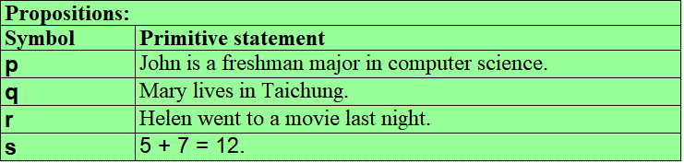
Propositional Logic
ALU of a computer CPU is responsible arithmetic operations and logical operations. Logical operators are connectors such as AND, OR, and NOT that connect statements.
In the mathematical theory of a logical system, a proposition is in one of three forms: a primitive statement, a unary connector, and a number of binary connectors.
A primitive statement is a statement describing a fact and is denoted by an English letter. For example,

Slide 3
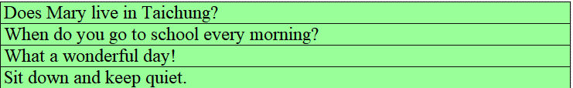
Propositional Logic (cont’d)
However, a question, an exclamation, or a command is not a logical primitive statement. For example,
The unary connector is the negation operator that transforms a statement p into
¬p (NOT p).
The binary connectors are
conjunction, p∧q (p AND q),
disjunction, p∨q (p OR q),
exclusive or, p⊕q (p XOR q),
implication, p⇒q (p implies q), and
equivalence, p⇔q (p if and only if q).

Slide 4

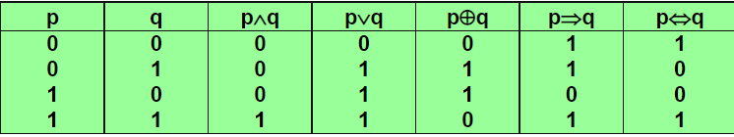
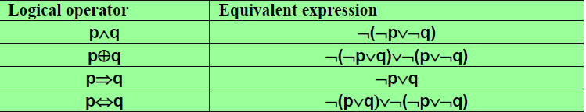
Propositional Logic (cont’d)
A primitive statement has a truth value of true or false, that is denoted as T or F, or as 1 or 0, respectively.
The truth and falsity of the negation and other operations is given as the following truth tables:
Among these logical operators, negation (¬) and disjunction (∨) are sufficient to construct the other operators.

Slide 5
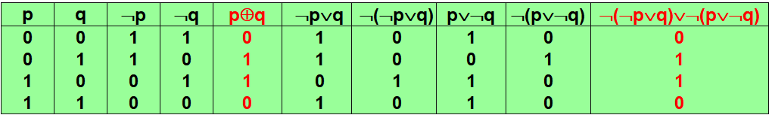
Propositional Logic (cont’d)
The above equivalent formulas can be proved by constructing the truth table of the expressions.
We show verification of p⊕q ≡ ¬(¬p∨q)∨¬(p∨¬q) and leave the other equivalent formulas for your own practice.

Slide 6
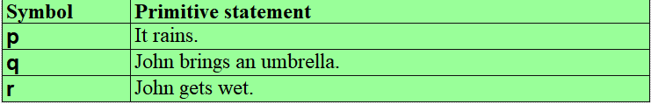
Propositional Logic (cont’d)
To express an English statement into logical expressions, a statement is split into a number of primitive statements and is denoted as an English letter.
The followings are examples of primitive statements:
We show examples of translating English sentences to logical expression as below:

Slide 7
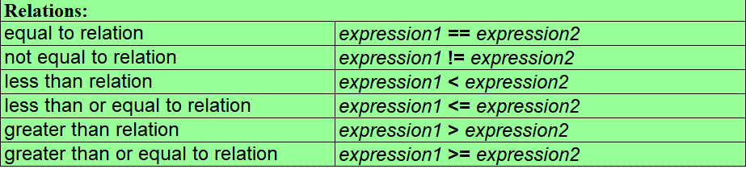
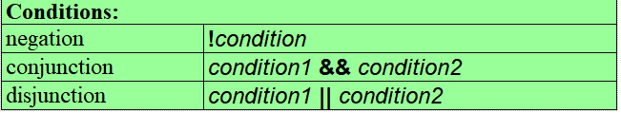
Relations and Logical Expressions in C
Predicates in C programming language are called logical expressions or conditions.
The primitive statements of conditions are either relations or Boolean functions.
A relation is a comparison of two arithmetic expressions of the following syntax:
In C programming language, conditions are connected by operators negation (!), conjunction (&&), and disjunction (||).

Slide 8
Relations and Logical Expressions in C (cont’d)
The truth values are represented as a number of any type.
Value 0 is used to represent false and any value other than 0 is used to represent true.
Often, value 1 is returned when a relation is evaluated to true.
Program truthValues.c shows examples of conditions:
truthValues.c
truthValues.exe
1
2
3
4
5
6
7
8
9
10
#include <stdio.h>
int main(void) {
printf("Truth: %d", 1==1);
printf("False: %d", 1!=1);
printf("Negation: %d\n", !(1==1));
printf("Conjunction: %d\n", 1==1 && 1>0);
printf("Disjunction: %d\n", 1!=1 || 1>0);
return 0;
}
Truth: 1
False: 0
Negation: 0
Conjunction: 1
Disjunction: 1

Slide 9
Conditional Statements in C
C programming language supports two kinds of conditional statements: if-then-else statements and switch-case statements.
if-then-else statements:
Syntax: if (condition) statement;
if (condition) statement1; else statement2;
A statement in the then clause and else clause can be a block statement, i.e., a sequence of statements enclosed by a pair of curly brackets { }.
The first syntactic form is also called an if-then statement. That is, the else clause in this case is the null statement.
The semantics of if-then statement and if-then-else statement is:
if-then statement: if condition is evaluated to true (i.e., to a value other than 0), then statement in the then clause is executed; otherwise the if-then statement does nothing.
if-then-else statement: if condition is evaluated to true (i.e., to a value other than 0), then statement1 in the then clause is executed; otherwise, statement2 in the else clause is executed.

Slide 10
Conditional Statements in C (cont’d)
When execution of either the then clause or the else clause is completed, program execution continues to the next statement following the conditional statement.
Example, assign the absolute value of variable x to y:
Example, assign the maximum value of variables of x and y to z:
C programming language provides a ternary operation (an operation with three operands) ? : to write a conditional statement in a brief way.
Syntax: condition ? expression1 : expression2
The semantics of the ternary expression is that if condition is evaluated to true (values other than 0) then expression1 is executed; otherwise, expression2 is executed.
With this ternary operation, we can rewrite the program computing maximum value to:
if (x<0) y = -x;
else y = x;
if (x>=y) z = x;
else z = y;
z = (x>=y) ? x : y;

Slide 11
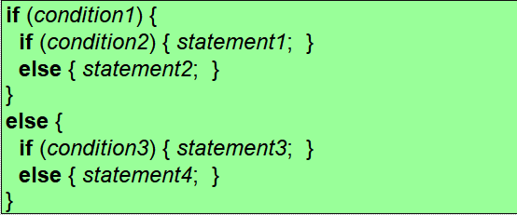
Nested Conditional Statements
Conditional statements can be enclosed in another conditional statements, i.e., they can be written as a nested conditional statements.
For example, a possible form is to enclose two inner if-then-else statements in the then clause and the else clause of the outer if-then-else statement:
Assign the maximum value of three variables x, y, and z to ans：
if (x>=y)
if (x>=z) ans = x;
else ans = z;
else
if (y>=z) ans = y;
else ans = z;

Slide 12
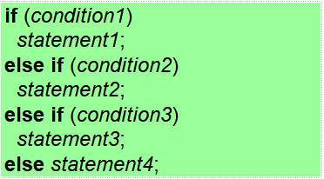
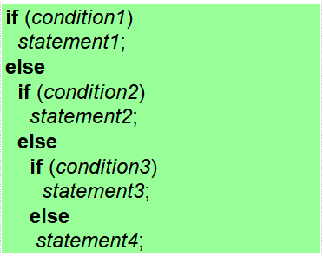
Nested Conditional Statements (cont’d)
Another form of if-then-else statements which is frequently used in C programs is called else-if construct: (left-hand-side figure)
If we rewrite the else-if construct with proper indentation, the exact syntax is: (right-hand-side figure)

Slide 13
Nested Conditional Statements (cont’d)
Rewrie assignment of the maximum value of three variables x, y, and z to ans：
if (x>=y && x>=z) ans = x;
else if (x<y && y>=z) ans = y;
else ans = z;

Slide 14
switch-case Statements
In C programming language, switch-case statements are used to implement a special form of the else-if construct when all of the conditions are equality tests of a given variable on a finite cases (usually a small number of cases) of discrete values.
Syntax: switch (variable) {
case value1: statement1;
case value2: statement2;
case value3: statement3;
case value4: statement4;
default: statement5;
}
The number of case lines can be as many as needed and the default line is optional.
The semantics of a switch-case statement is the value of variable is compared with values from the first to the last case in the specified order. Once one value of the case clause is matched, all statements following the case clause are executed unless a break statement is encountered.
A switch-case statement is complete if the execution reaches a break statement or the last statement.

Slide 15
switch-case Statements (cont’d)
Program print_numbers_no_break.c uses a switch-case statement to print numbers of one, two, three, and four.
If only one number is going to be output, a break statement must be added after every printf() as in program print_number_with_break.c.
In a switch-case statement, multiple values can be placed in consecutive case clauses without specific order.

Slide 16
print_numbers_no_break.c
print_numbers_no_break.exe
1
2
3
4
5
6
7
8
9
10
11
12
13
14
15
16
17
#include <stdio.h>
int main(void) {
int x;
printf("Enter an integer: ");
scanf("%d", &x);
switch (x) {
case 1: printf("one\n");
case 2: printf("two\n");
case 3: printf("three\n");
case 4: printf("four\n");
default: printf("others\n");
}
return 0;
}
Enter an integer: 2
two
three
four
others
Lines 9 to 15 make up a switch-case statement.
Since the value of x is set to 2, statements starting from case 2: are executed.
Hence, two, three, four, and others are output because there is not break statement after any case.

Slide 17
print_number_with_break.c
print_number_with_break.exe
1
2
3
4
5
6
7
8
9
10
11
12
13
14
15
16
17
#include <stdio.h>
int main(void) {
int x;
printf("Enter an integer: ");
scanf("%d", &x);
switch (x) {
case 1: { printf("one\n"); break; }
case 2: { printf("two\n"); break; }
case 3: { printf("three\n"); break; }
case 4: { printf("four\n"); break; }
default: printf("others\n");
}
return 0;
}
Enter an integer: 2
two
In fact, the switch-case statement from Line 9 to 17 can be written with the following else-if construct:
if (x==1) printf("one\n");
else if (x==2) printf("two\n");
else if (x==3) printf("three\n");
else if (x==4) printf("four\n");
else printf("others\n");

Slide 18
1
2
3
4
5
6
7
8
9
10
11
12
13
14
15
16
17
18
19
20
#include <stdio.h>
int main(void) {
int x;
printf("Enter an integer: ");
scanf("%d", &x);
switch (x) {
case 11:
case 1: { printf("one\n"); break; }
case 2:
case 12: { printf("two\n"); break; }
case 13:
case 3: { printf("three\n"); break; }
case 4: { printf("four\n"); break; }
default: printf("others\n");
}
return 0;
}
Enter an integer: 12
two
If x is entered as12, the output value is two.

Slide 19
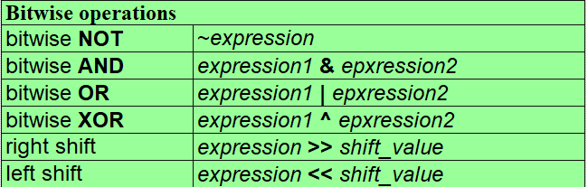
Bitwise Operations in C
Another type of logical expressions in C is bitwise operations.
A bitwise operator is a binary operator applying to corresponding bits of two expressions of the same data length or applying to an expression and an integer.
There are six bitwise operations defined in C programming language:

Slide 20
Bitwise Operations in C (cont’d)
The expressions in bitwise operations must be of fixed length.
For example, 8-bit long for the characters, 16-bit long for short integers, and 32-bit long for integers.
In addition, for bitwise AND, bitwise OR, and bitwise XOR, the two expressions must have identical bit length.
For right shift and left shift operations, the shift value is an integer value.
bitwiseNot.c
bitwiseNot.exe
Bitwise NOT reverses the value of each individual bit of its operand, i.e., it performs one's complement of the operand.
1
2
3
4
5
6
7
8
9
10
#include <stdio.h>
int main(void) {
unsigned char x = 0x46, y;
y = ~x;
printf("x: %X, y: %X\n", x, y);
return 0;
}
x: 46, y: B9
Variable x is set to 8-bit hexadecimal value 46₁₆=01000110₂, and then its negation is assigned to variable y in Line 6. We obtain the value of y to be 46₁₆=0100 0110₂=1011 1001₂=B9₁₆.

Slide 21
Bitwise Operations in C (cont’d)
Bitwise AND, OR, and XOR perform AND, OR, and XOR operations on individual bits of the two operands.
bitwiseAndOrXor.c
bitwiseAndOrXor.exe
1
2
3
4
5
6
7
8
9
10
11
12
13
14
15
#include <stdio.h>
int main(void) {
unsigned char x = 0x46, y;
y = x & 0x00;
printf("Bitwise AND\tx: %02X, y: %02X\n", x, y);
y = x | 0xFF;
printf("Bitwise OR\tx: %02X, y: %02X\n", x, y);
y = x ^ 0xFF;
printf("Bitwise XOR\tx: %02X, y: %02X\n", x, y);
return 0;
}
Bitwise AND x: 46, y: 00
Bitwise OR x: 46, y: FF
Bitwise XOR x: 46, y: B9
Variable x is initialized to hexadecimal value 46₁₆. In Line 5, the value of variable y is set to x∧0 that sets all bits of x to 0's. In Line 8, the value of variable y is set to x∨255 that sets all bits of x to 1's. In line 11, the value of variable y is set to x⊕255 that reverses all bits of x as bitwise NOT does.

Slide 22
Bitwise Operations in C (cont’d)
Bitwise shift is to shift the bits of its first operand to the right-hand-side or the left-hand-side a number of positions specified by its second operand.
bitwiseShift.c
bitwiseShift.exe
1
2
3
4
5
6
7
8
9
10
11
12
#include <stdio.h>
int main(void) {
unsigned char x = 0x46, y;
y = x >> 4;
printf("Bitwise right shift\tx: %02X, y: %02X\n", x, y);
y = x << 4;
printf("Bitwise left shift\tx: %02X, y: %02X\n", x, y);
return 0;
}
Bitwise right shift x: 46, y: 04
Bitwise left shift x: 46, y: 60
Variable x is initialized to hexadecimal value 46₁₆.
In Line 6, the value of variable y is set to x after shifting to the right-hand-side four positions and the four bits on the left-hand-side are filled in with 0's. In Line 9, the value of variable y is set to x after shifting to the left-hand-side four positions and the four bits on the right-hand-side are filled in with 0's.

Slide 23
Bitwise Operations in C (cont’d)
Bitwise logical operations are often used in programs to efficiently perform certain arithmetic operations.
Left shift an integer one position is equivalent to the product of multiplying this integer by 2.
Right shift an integer one position is equivalent to the quotient of dividing this integer by 2.
Conjunction operation of an integer with 1 is equivalent to the remainder of dividing this integer by 2.
The general rules are:
Left shift an integer k positions is equivalent to the product of multiplying this integer by 2^{k}.
Right shift an integer k positions is equivalent to the quotient of dividing this integer by 2^{k}.
Conjunction operation of an integer with 2^{k}-1 is equivalent to the remainder of dividing this integer by 2^{k}.

Slide 24
Bitwise Operations in C (cont’d)
Variable x=3455 and k=6, i.e., 2^{k}=64.
bitwiseArithmetic.c
bitwiseArithmetic.exe
1
2
3
4
5
6
7
8
9
10
11
12
13
#include <stdio.h>
int main(void) {
unsigned int x = 3455;
printf("x=%d, x<<6=%d, x*64=%d\n", x, x<<6, x*64);
printf("x=%d, x>>6=%d, x/64=%d\n", x, x>>6, x/64);
printf("x=%d, x&63=%d, x%%64=%d\n", x, x&63, x%64);
return 0;
}
x=3455, x<<6=221120, x*64=221120
x=3455, x>>6=53, x/64=53
x=3455, x&63=63, x%64=63
Line 6 show sthat x<<6 and x*64 have the same computational result.
Line 8 shows that x>>6 and x/64 have the same computational result.
Line 10 show that x&63 and x%64 have the same computational result.

Slide 25
Bitwise Operations in C (cont’d)
For two positive integers, if the non-zero bits of binary representation of these two integers do not overlap, their sum can be implemented as a bitwise OR operation of the two integers.
bitwiseSum.c
bitwiseSum.exe
1
2
3
4
5
6
7
8
9
10
11
12
13
#include <stdio.h>
int main(void) {
int x=50432, y=125;
int sum;
sum = x | y;
printf("x=%d, y=%d, sum=%d\n", x, y, sum);
printf("x+y=%d\n", x+y);
return 0;
}
x=50432, y=125, sum=50557
x+y=50557
Variable x is set to 50432₁₀=C500₁₆ and variable y is set to 125₁₀=7D₁₆.
Since the non-zero bits of x and y do not overlap, bitwise OR of the two numbers is equivalent to an addition.

Slide 26
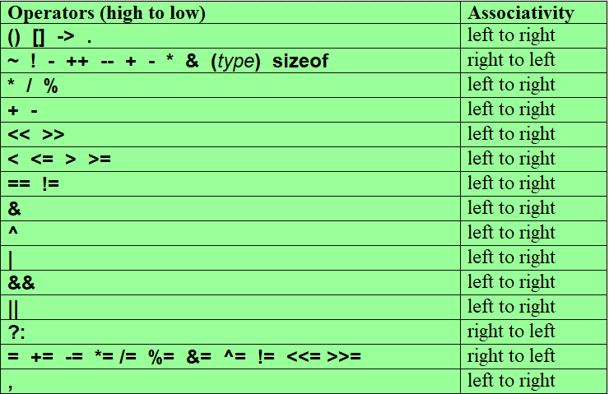
Precedence Rules and Associativity Rules: Summary

